Slide 1
Elevated Moist Layers – Retrieval of Complex Humidity Structures with IASI
Marc Prange^{1,2}
Manfred Brath¹, Stefan Buehler¹
¹Universität Hamburg
²IMPRS-ESM, Hamburg
Notes:
First part of the talk is about moist layers in the tropical mid troposphere, where I want to show that these layers are somewhat statistically significant, physically relevant and also intersting to study.
Second part of the talk will be more specifically about what I do in my own research project, namely to investigate wheather we can observe these moist layers from space.

Slide 2
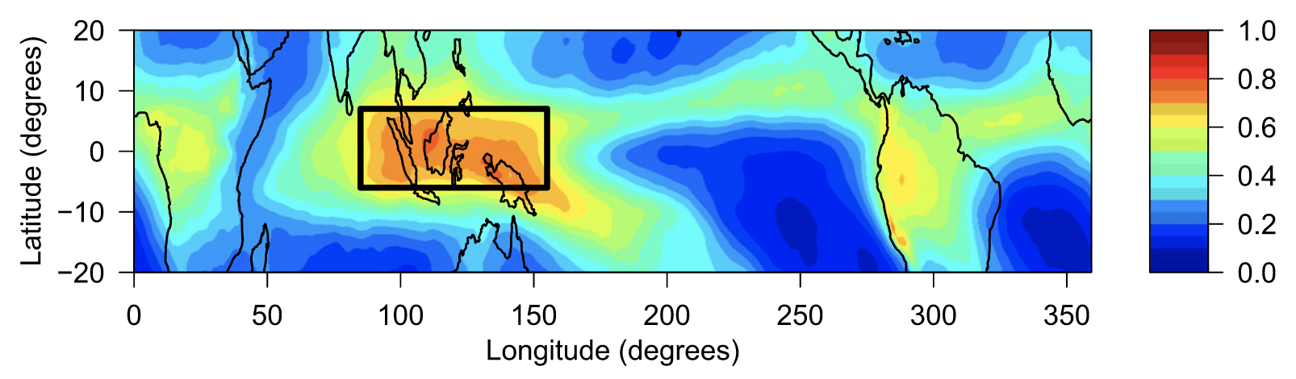
Relative Humidity in the tropics
Romps, et al. (2014), Journal of Climate
ERA – Interim 500 hPa relative humidity
1
Notes:
Detrainment of moist air into the environment from these 3 levels has distinct footprint on the vertical humidity structure: Hydrolapse at trade inversion, C shape of the RH profile due to detrainment at the tropopause.

Slide 3
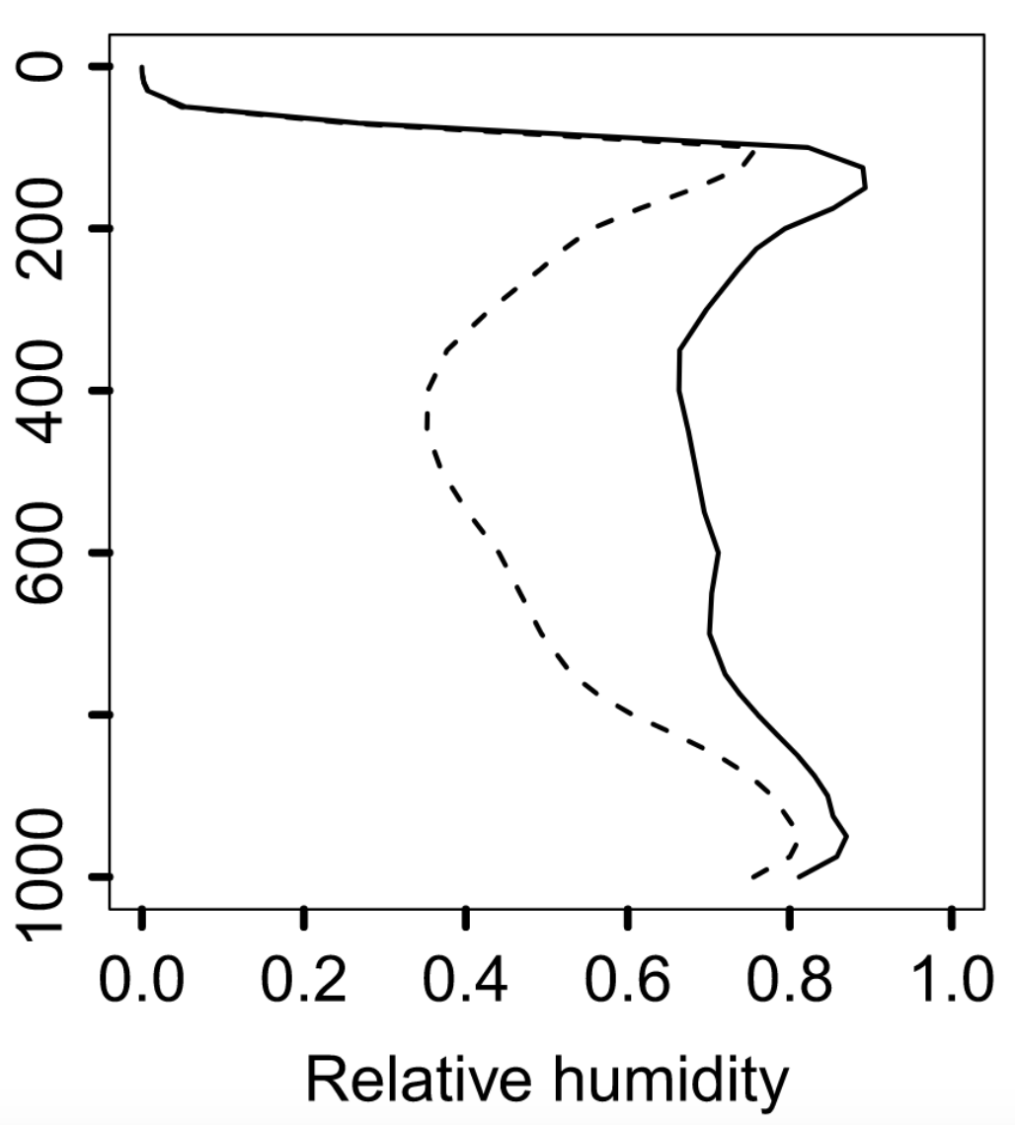
Relative Humidity in the tropics
Romps, et al. (2014), Journal of Climate
ERA – Interim 500 hPa relative humidity
1 year average ERA - Interim
Tropical mean vertical RH structure: C-shape
-- tropical mean
warm pool
1
Notes:
Detrainment of moist air into the environment from these 3 levels has distinct footprint on the vertical humidity structure: Hydrolapse at trade inversion, C shape of the RH profile due to detrainment at the tropopause.

Slide 4
Relative Humidity in the tropics
Romps, et al. (2014), Journal of Climate
ERA – Interim 500 hPa relative humidity
1 year average ERA - Interim
0˚C
Tropical mean vertical RH structure: C-shape
Western Pacific warm pool:
  Moistened mid troposphere
  Secondary RH maximum near freezing level
  → Elevated Moist Layers (EMLs) detrained
  from deep convection
-- tropical mean
warm pool
1
Notes:
Detrainment of moist air into the environment from these 3 levels has distinct footprint on the vertical humidity structure: Hydrolapse at trade inversion, C shape of the RH profile due to detrainment at the tropopause.

Slide 5
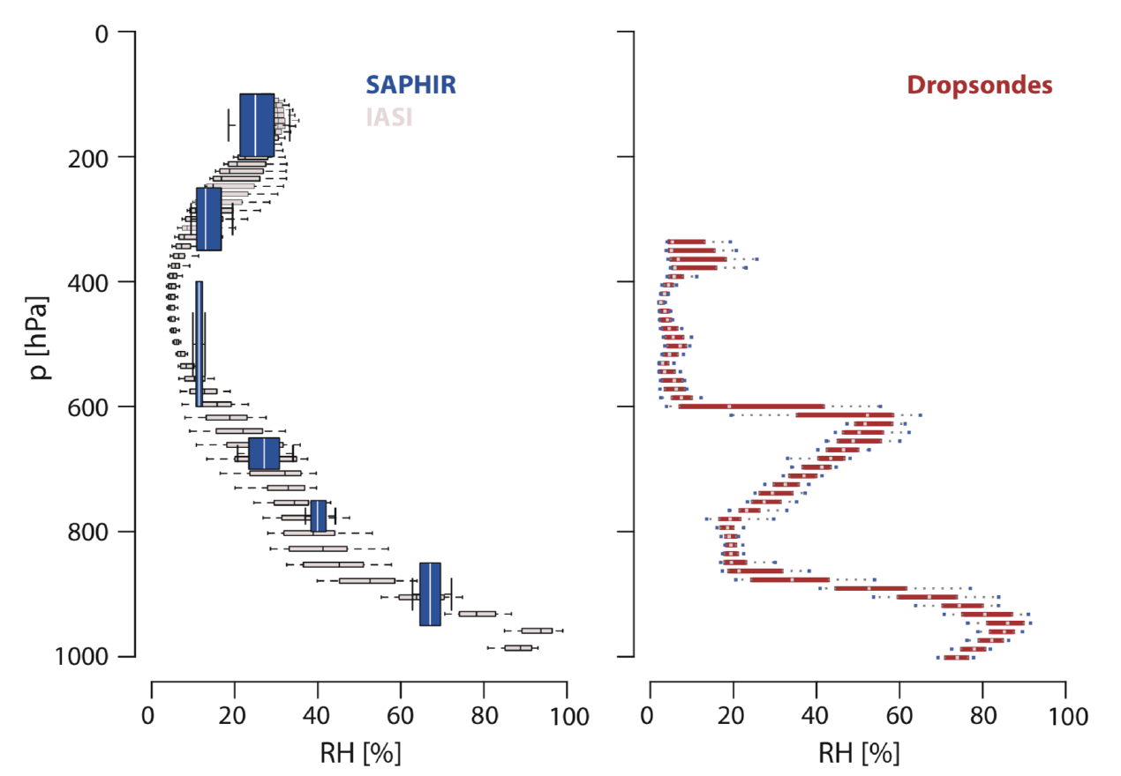
Retrieval case study of an EML
HALO Research Flight during NARVAL-2
Stevens et al. (2017),
Surv. Geophys.
2

Slide 6
Retrieval case study of an EML
HALO Research Flight during NARVAL-2
0˚C
Stevens et al. (2017),
Surv. Geophys.
2

Slide 7
Retrieval case study of an EML
HALO Research Flight during NARVAL-2
0˚C
0˚C
2

Slide 8
Retrieval case study of an EML
HALO Research Flight during NARVAL-2
no EML
EML
Stevens et al. (2017),
Surv. Geophys.
3

Slide 9
Retrieval case study of an EML
HALO Research Flight during NARVAL-2
Is there an inherent EML blindspot?
Use “synthetic“ retrieval setup
to check hypothesis for blindspot
no EML
EML
Stevens et al. (2017),
Surv. Geophys.
3

Slide 10
Retrieval case study of an EML
HALO Research Flight during NARVAL-2
Is there an inherent EML blindspot?
Use “synthetic“ retrieval setup
to check hypothesis for blindspot
Note: In Prange et al. (2021, AMT)
we discuss more retrieval literature
in this context.
→ Regression retrievals struggle
→ Physical retrievals do better
no EML
EML
Stevens et al. (2017),
Surv. Geophys.
3

Slide 11
Synthetic retrieval case study of an EML
Retrieval setup:
Optimal Estimation with
Levenberg-Marquardt scheme
Atmospheric Radiative
Transfer Simulator (ARTS)
Assume clear-sky ocean scene
4

Slide 12
Synthetic retrieval case study of an EML
Retrieval setup:
Optimal Estimation with
Levenberg-Marquardt scheme
Atmospheric Radiative
Transfer Simulator (ARTS)
Assume clear-sky ocean scene
Simultaneous retrieval of
log(VMR_{H2O}) and temperature
Use same spectral ranges as
Stevens et al. (2017)
4

Slide 13
Synthetic retrieval case study of an EML
Retrieval setup:
Optimal Estimation with
Levenberg-Marquardt scheme
Atmospheric Radiative
Transfer Simulator (ARTS)
Assume clear-sky ocean scene
Simultaneous retrieval of
log(VMR_{H2O}) and temperature
Use same spectral ranges as
Stevens et al. (2017)
H₂O
CO₂
O₃
CO₂
Stevens et al. (2017), Surv. Geophys.
4

Slide 14
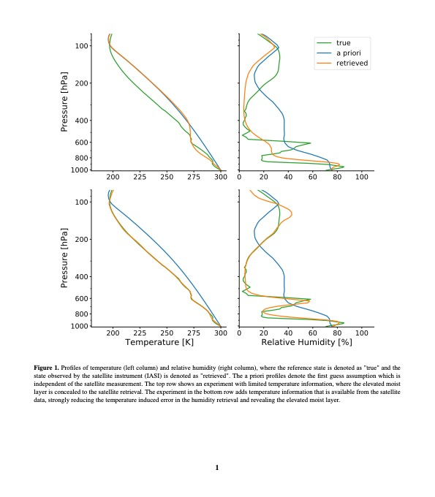
Synthetic retrieval case study of an EML
Retrieval setup:
Optimal Estimation with
Levenberg-Marquardt scheme
Atmospheric Radiative
Transfer Simulator (ARTS)
Assume clear-sky ocean scene
Simultaneous retrieval of
log(VMR_{H2O}) and temperature
Use same spectral ranges as
Stevens et al. (2017)
5

Slide 15
Synthetic retrieval case study of an EML
Retrieval setup:
Optimal Estimation with
Levenberg-Marquardt scheme
Atmospheric Radiative
Transfer Simulator (ARTS)
Assume clear-sky ocean scene
Simultaneous retrieval of
log(VMR_{H2O}) and temperature
Use same spectral ranges as
Stevens et al. (2017)
→ Adjust spectral range
H₂O
CO₂
O₃
CO₂
Add H₂O independent temperature information
6

Slide 16
Synthetic retrieval case study of an EML
Retrieval setup:
Optimal Estimation with
Levenberg-Marquardt scheme.
Atmospheric Radiative
Transfer Simulator (ARTS)
Assume clear-sky ocean scene.
Simultaneous retrieval of
log(VMR_{H2O}) and temperature
Use same spectral ranges as
Stevens et al. (2017)
→ Adjust spectral range
7

Slide 17
Synthetic retrieval case study of an EML
Retrieval setup:
Optimal Estimation with
Levenberg-Marquardt scheme
Atmospheric Radiative
Transfer Simulator (ARTS)
Assume clear-sky ocean scene
Simultaneous retrieval of
log(VMR_{H2O}) and temperature
Use same spectral ranges as
Stevens et al. (2017)
→ Adjust spectral range
Case study shows that blindspot
can be reproduced and circumvented.
7

Slide 18
Synthetic retrieval case study of an EML
Retrieval setup:
Optimal Estimation with
Levenberg-Marquardt scheme
Atmospheric Radiative
Transfer Simulator (ARTS)
Assume clear-sky ocean scene
Simultaneous retrieval of
log(VMR_{H2O}) and temperature
Use same spectral ranges as
Stevens et al. (2017)
→ Adjust spectral range
Case study shows that blindspot
can be reproduced and circumvented.
How do these results apply to real observations?
7

Slide 19
Retrieval of EMLs by operational L2 products
Procedure: Identify EML cases and quantify them in retrieval and reference dataset
8

Slide 20
Retrieval of EMLs by operational L2 products
Procedure: Identify EML cases and quantify them in retrieval and reference dataset
⏤ humidity profile
--- reference profile
dry anomaly
moist anomaly
8

Slide 21

Retrieval of EMLs by operational L2 products
Procedure: Identify EML cases and quantify them in retrieval and reference dataset
Reference profile:
2nd order least square fit of
log-humidity profile:
Fit from surface to 100 hPa.
Only consider anomalies between
900 and 100 hPa.
⏤ humidity profile
--- reference profile
dry anomaly
moist anomaly
$$\ln\left({VMR}_{H_{2}O, ref}\right)=az^{2}+bz+c$$
8

Slide 22



Retrieval of EMLs by operational L2 products
Procedure: Identify EML cases and quantify them in retrieval and reference dataset
Reference profile:
2nd order least square fit of
log-humidity profile:
Fit from surface to 100 hPa.
Only consider anomalies between
900 and 100 hPa.
⏤ humidity profile
--- reference profile
dry anomaly
moist anomaly
$$\ln\left({VMR}_{H_{2}O, ref}\right)=az^{2}+bz+c$$
8

Slide 23
Retrieval of EMLs by operational L2 products
Procedure: Identify EML cases and quantify them in retrieval and reference dataset
Reference profile:
2nd order least square fit of
log-humidity profile:
Fit from surface to 100 hPa.
Only consider anomalies between
900 and 100 hPa.
Apply to retrieval product and reference
dataset, then compare metrics statistically.
⏤ humidity profile
--- reference profile
dry anomaly
moist anomaly
$$\ln\left({VMR}_{H_{2}O, ref}\right)=az^{2}+bz+c$$
8

Slide 24
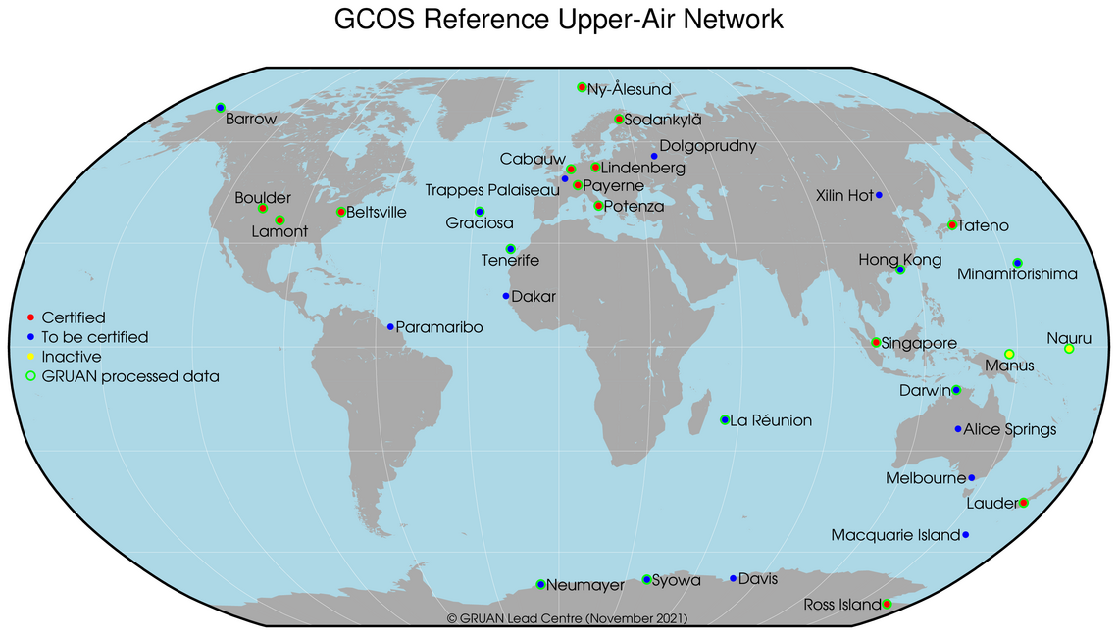
Retrieval of EMLs by operational L2 products
Procedure: Identify EML cases and quantify them in retrieval and reference dataset
GRUAN radiosondes:
long-term high quality
radiosonde data records
https://www.gruan.org/network/sites, 30.11.2021
9

Slide 25
Retrieval of EMLs by operational L2 products
Procedure: Identify EML cases and quantify them in retrieval and reference dataset
GRUAN radiosondes:
long-term high quality
radiosonde data records
Western Pacific warm
pool well suited
→ Deep convection
https://www.gruan.org/network/sites, 30.11.2021
9

Slide 26
Retrieval of EMLs by operational L2 products
Procedure: Identify EML cases and quantify them in retrieval and reference dataset
GRUAN radiosondes:
long-term high quality
radiosonde data records
Western Pacific warm
pool well suited
→ Deep convection
Manus Island:
2011 – 2014
min. 2 soundings/day
UTC +10 hours
→ 00/12 UTC soundings
coincide with IASI
crossing time within 30 min
https://www.gruan.org/network/sites, 30.11.2021
9

Slide 27
Moist anomaly characteristics – GRUAN / IASI L2
Data base:
2012 GRUAN soundings for
Manus Island (829 soundings)
EUMETSAT IASI L2 product
10

Slide 28
Moist anomaly characteristics – GRUAN / IASI L2
Data base:
2012 GRUAN soundings for
Manus Island (829 soundings)
EUMETSAT IASI L2 product
Procedure:
Collocate IASI L2 data with
GRUAN soundings using critieria:
  50 km distance
  30 min interval
  → Yields 2061 collocations,
  551 after quality filtering
Calculate moist anomaly
characteristics for each
collocated profile.
10

Slide 29
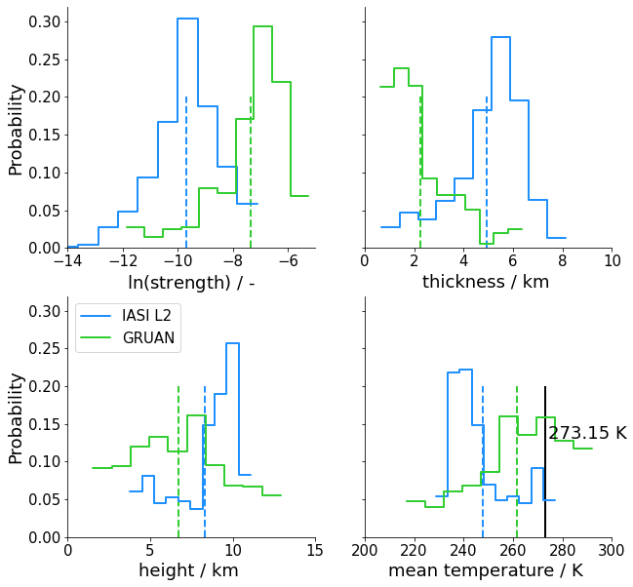
Moist anomaly characteristics – GRUAN / IASI L2
Data base:
2012 GRUAN soundings for
Manus Island (829 soundings)
EUMETSAT IASI L2 product
Procedure:
Collocate IASI L2 data with
GRUAN soundings using critieria:
  50 km distance
  30 min interval
  → Yields 2061 collocations,
  551 after quality filtering
Calculate moist anomaly
characteristics for each
collocated profile.
10

Slide 30
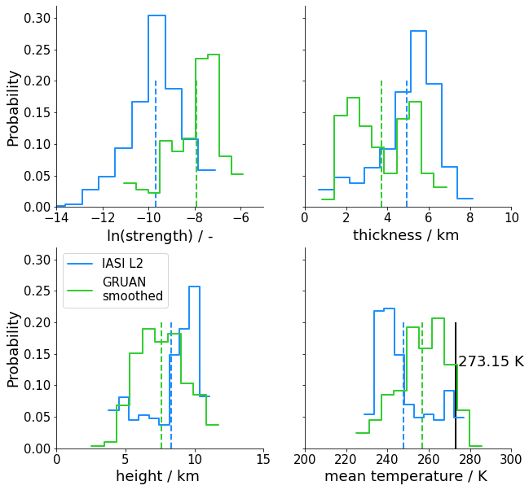
Moist anomaly characteristics – GRUAN / IASI L2
Data base:
2012 GRUAN soundings for
Manus Island (829 soundings)
EUMETSAT IASI L2 product
Procedure:
Collocate IASI L2 data with
GRUAN soundings using critieria:
  50 km distance
  30 min interval
  → Yields 2061 collocations,
  551 after quality filtering
Calculate moist anomaly
characteristics for each
collocated profile.
11

Slide 31
Moist anomaly characteristics – ERA5 / IASI L2
Data base:
2012 ERA5 reanalysis data on
137 vertical levels.
EUMETSAT IASI L2 product
Procedure:
Collocate IASI L2 data with
ERA5 using critieria:
  50 km distance
  30 min interval
  → Yields 65181 collocations,
  17970 after quality filtering
Calculate moist anomaly
characteristics for each
collocated profile.
12

Slide 32
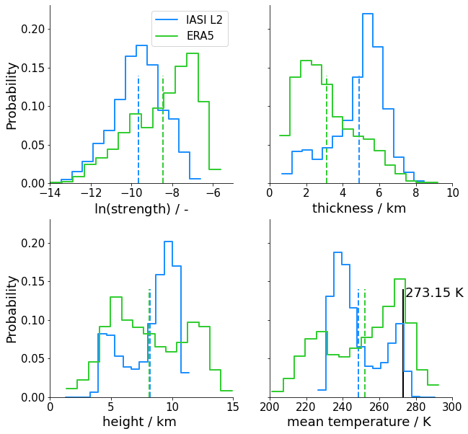
Moist anomaly characteristics – ERA5 / IASI L2
Data base:
2012 ERA5 reanalysis data on
137 vertical levels.
EUMETSAT IASI L2 product
Procedure:
Collocate IASI L2 data with
ERA5 using critieria:
  50 km distance
  30 min interval
  → Yields 65181 collocations,
  17970 after quality filtering
Calculate moist anomaly
characteristics for each
collocated profile.
12

Slide 33
Conclusion
There is no inherent EML blindspot for
hyperspectral infrared sounders.
The EUMETSAT IASI L2 retrieval shows significantly
different moist anomaly characteristics compared
to GRUAN soundings and ERA5:
  Strength 1-2 orders of magnitude lower
  Strong overestimation of anomaly thickness
Bimodality in anomaly height captured by retrieval,
but currently disagreements between all datasets.
→ To be continued…
13

Slide 34
Backup slides

Slide 35
Averaging kernels
Tropical mean
Moist Layer scenario

Slide 36
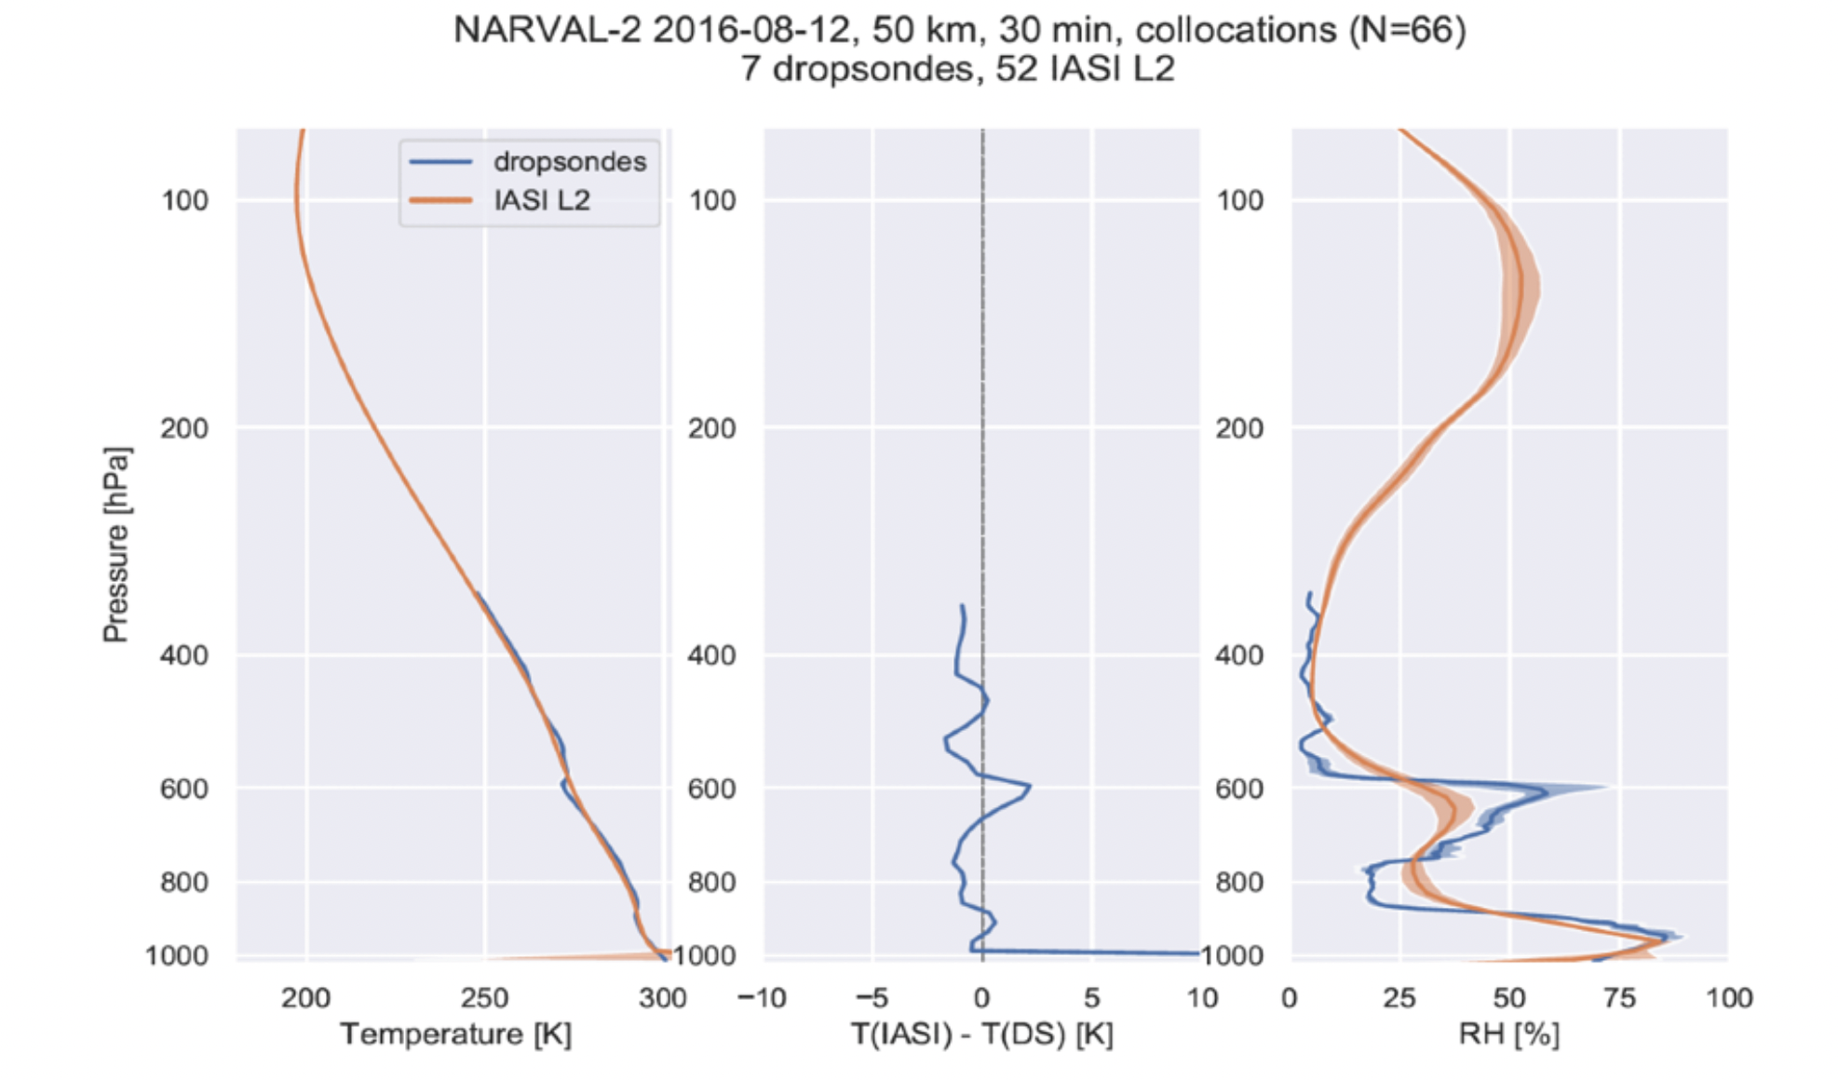
NARVAL-2 EML in IASI L2 EUMETSAT retrieval

Slide 37
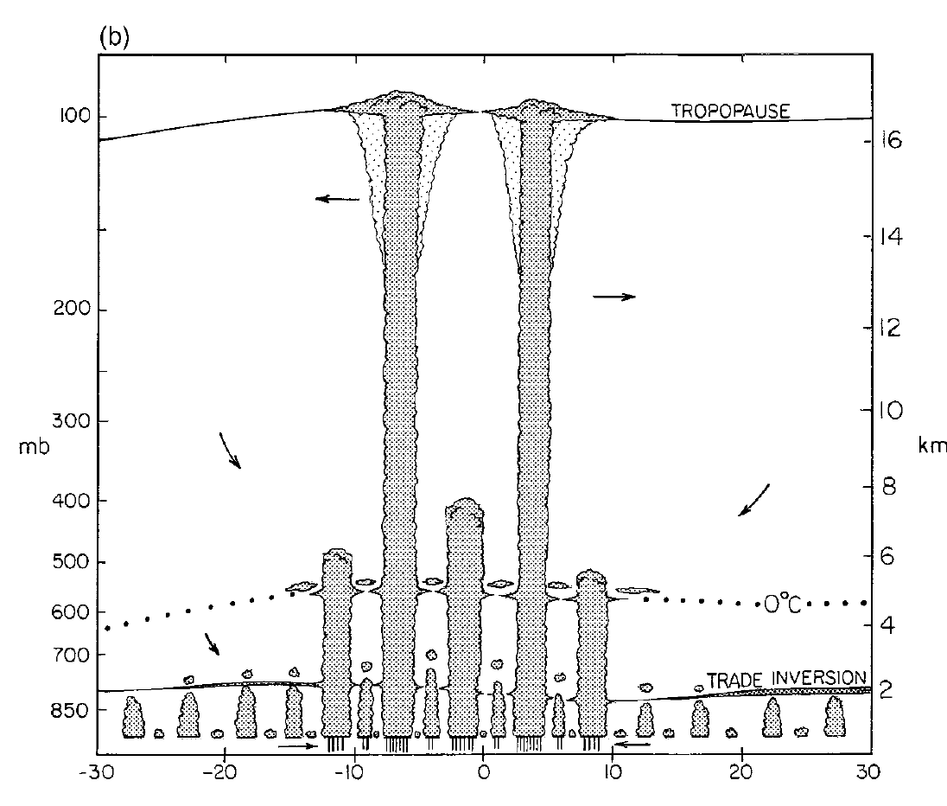
Trimodality of convection in the tropics
1 year average ERA - Interim
~ 0˚ C
Johnson et al. (1999),
Journal of Climate
Romps, et al. (2014),
Journal of Climate
1
Notes:
- Freezing Level doesn’t show up as much of a first order effect on the humidity profile, but in conjunction with rather deep convection, it has a statistically relevant signal.

Slide 38
What is an Elevated Moist Layer (EML)?
NARVAL-2 dropsondes
Elevated Moist layer
2
Notes:
Let’s look more closely at a particular case of a mid tropospheric moisture anomaly, from now on referred to as EML.
→ NARVAL-2

Slide 39
What is an Elevated Moist Layer (EML)?
NARVAL-2 dropsondes
Elevated Moist layer
0˚ C
2

Slide 40
What is an Elevated Moist Layer (EML)?
NARVAL-2 dropsondes
Elevated Moist layer
Elevated Stable layer
0˚ C
2

Slide 41
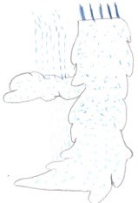


What is an Elevated Moist Layer (EML)?
NARVAL-2 dropsondes
Elevated Moist layer
0˚ C
2

Slide 42
What is an Elevated Moist Layer (EML)?
NARVAL-2 dropsondes
Elevated Moist layer
0˚ C
Detrainment of
moist air
2

Slide 43
What is an Elevated Moist Layer (EML)?
NARVAL-2 dropsondes
Radiative Cooling
Elevated Moist layer
0˚ C
Detrainment of
moist air
2

Slide 44
What is an Elevated Moist Layer (EML)?
NARVAL-2 dropsondes
Elevated Moist layer
Elevated Stable layer
0˚ C
Maximum radiative cooling
3

Slide 45
Moisture anomaly characteristics
height
strength
thickness
14

Slide 46
Moisture anomaly characteristics
Total count of anomalies
True: 2894
Retrieved: 2095
height
strength
thickness
14

Slide 47
Moisture anomaly characteristics
Total count of anomalies
True: 2894
Retrieved: 2095
Note:
EMLs around 0°C are subset of moisture anomalies.
height
strength
thickness
14

Slide 48
Moisture anomaly characteristics
height
strength
thickness
14

Slide 49
Moisture anomaly characteristics
Height:
Gap below 5 km
height
strength
thickness
14

Slide 50
Moisture anomaly characteristics
Height:
Gap below 5 km
Strength:
Overrepresentation of weak anomalies
height
strength
thickness
14

Slide 51
Moisture anomaly characteristics
Height:
Gap below 5 km
Strength:
Overrepresentation of weak anomalies
Thickness:
Gap for narrow anomalies
height
strength
thickness
14

Slide 52
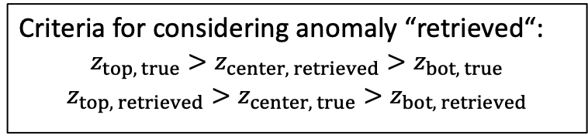
Gap in retrieved anomalies below 5 km
Anomaly
height:
Criteria for considering anomaly “retrieved“:
$$z_{top, true}>z_{center, retrieved}>z_{bot, true}$$
$$z_{top, retrieved}>z_{center, true}>z_{bot, retrieved}$$
thickness [km]
15

Slide 53
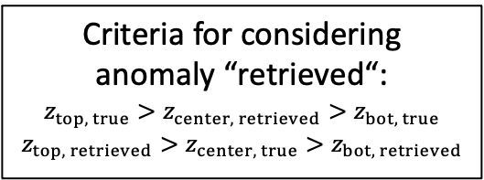
Gap in retrieved anomalies below 5 km
Anomaly
height:
Criteria for considering
anomaly “retrieved“:
$$z_{top, true}>z_{center, retrieved}>z_{bot, true}$$
$$z_{top, retrieved}>z_{center, true}>z_{bot, retrieved}$$
thickness [km]
thickness [km]
thickness [km]
15

Slide 54
Gap in retrieved anomalies below 5 km
Anomaly
height:
Criteria for considering
anomaly “retrieved“:
$$z_{top, true}>z_{center, retrieved}>z_{bot, true}$$
$$z_{top, retrieved}>z_{center, true}>z_{bot, retrieved}$$
Below 5 km most anomalies are much more narrow, than aloft.
thickness [km]
thickness [km]
thickness [km]
15

Slide 55
How do moisture anomaly characteristics determine the cooling rate?
Test dataset
anomaly strength [-]
17

Slide 56
How do moisture anomaly characteristics determine the cooling rate?
Test dataset
anomaly strength [-]
17

Slide 57
How do moisture anomaly characteristics determine the cooling rate?
Test dataset
anomaly strength [-]
17

Slide 58
How do moisture anomaly characteristics determine the cooling rate?
Test dataset
Retrieval
anomaly strength [-]
anomaly strength [-]
17

Slide 59
Gap in retrieved anomalies beneath 5 km
Test Dataset
Retrieval
→ Most anomalies are missed beneath 5 km, which are also the strongest.

